Slide 1
Algorithms
(Heap)

Slide 2
My Brief Profile
Nahian Salsabil (NNS)
Lecturer, CSE, BRACU
BSc: CSE, BUET, 2023
Email: Email: nahian.salsabil@bracu.ac.bd

Slide 3
Outline
Heap

Slide 4
Heap

Slide 5
Heap
Special Binary Tree
Underlying data structure is array (random access easier)
Heap Property:
Max Heap: value of the parent >= value of the children
Min Heap: value of the parent <= value of the children
Max heap is mostly used

Slide 6
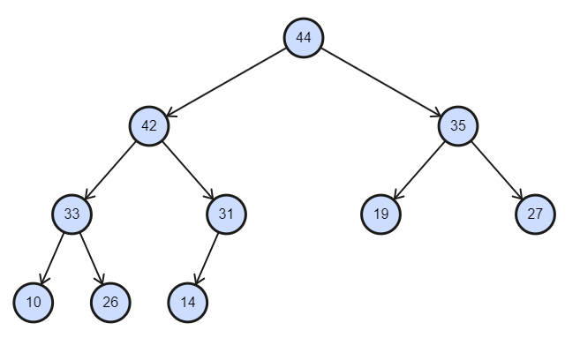
Heap
Max Heap

Slide 7
Heap
Array Representation:
44 | 42 | 35 | 33 | 31 | 19 | 27 | 10 | 26 | 14

Slide 8
Heap
For ith node, it’s parent node is i/2
For ith node, it’s left child is 2i
For ith node, it’s right child is 2i + 1
Array Representation:
Index:
1 | 2 | 3 | 4 | 5 | 6 | 7 | 8 | 9 | 10
44 | 42 | 35 | 33 | 31 | 19 | 27 | 10 | 26 | 14
Index start from 1!

Slide 9
Heap Operation: Insert()
Insert 20
Array Representation:
Index:
1 | 2 | 3 | 4 | 5 | 6 | 7 | 8 | 9 | 10
44 | 42 | 35 | 33 | 31 | 19 | 27 | 10 | 26 | 14

Slide 10
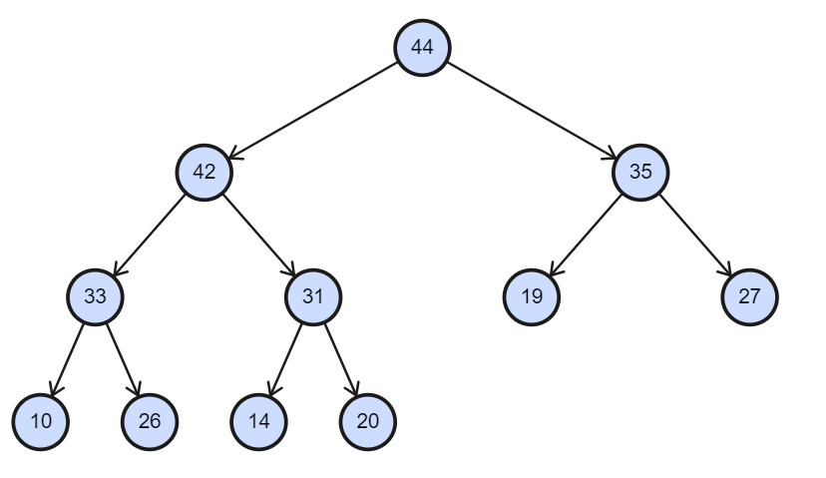
Heap Operation: Insert()
Insert 20
Array Representation:
Index:
1 | 2 | 3 | 4 | 5 | 6 | 7 | 8 | 9 | 10 | 11
44 | 42 | 35 | 33 | 31 | 19 | 27 | 10 | 26 | 14 | 20

Slide 11
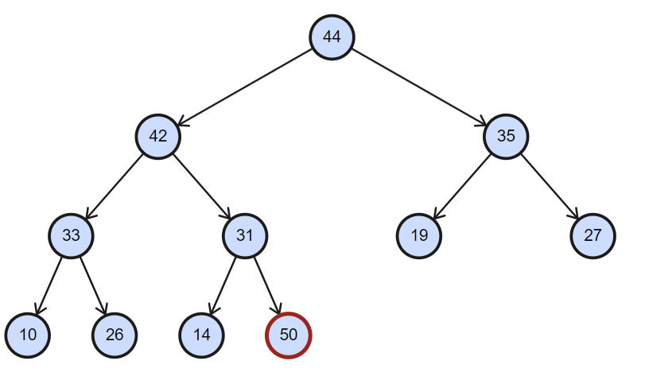
Heap Operation: HeapIncreaseKey()/Swim()
Insert 50
Array Representation:
Index:
1 | 2 | 3 | 4 | 5 | 6 | 7 | 8 | 9 | 10 | 11
44 | 42 | 35 | 33 | 31 | 19 | 27 | 10 | 26 | 14 | 50

Slide 12
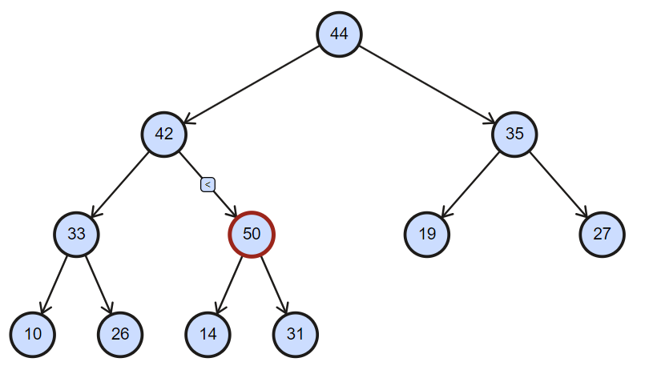
Heap Operation: HeapIncreaseKey()/Swim()
Insert 50
Array Representation:
Index:
1 | 2 | 3 | 4 | 5 | 6 | 7 | 8 | 9 | 10 | 11
44 | 42 | 35 | 33 | 50 | 19 | 27 | 10 | 26 | 14 | 31

Slide 13
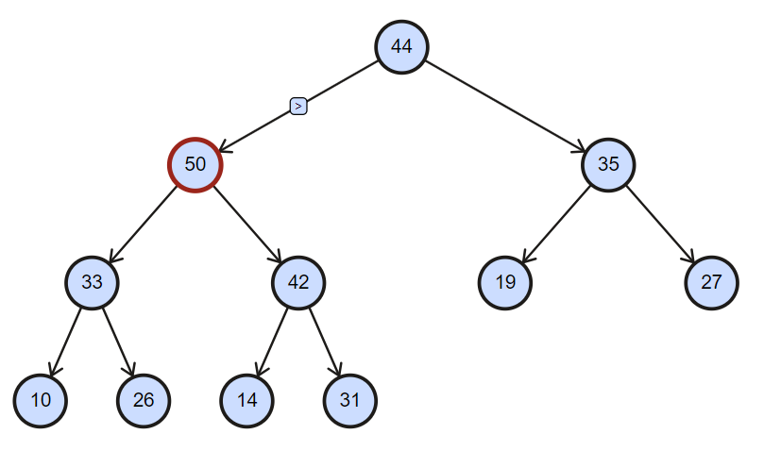
Heap Operation: HeapIncreaseKey()/Swim()
Insert 50
Array Representation:
Index:
1 | 2 | 3 | 4 | 5 | 6 | 7 | 8 | 9 | 10 | 11
44 | 50 | 35 | 33 | 42 | 19 | 27 | 10 | 26 | 14 | 31

Slide 14
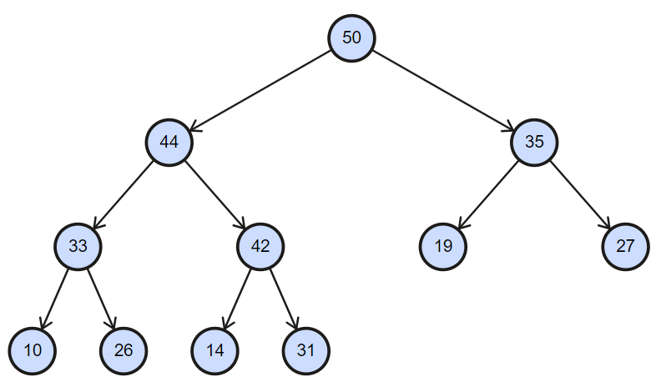
Heap Operation: HeapIncreaseKey()/Swim()
Insert 50
Array Representation:
Index:
1 | 2 | 3 | 4 | 5 | 6 | 7 | 8 | 9 | 10 | 11
50 | 44 | 35 | 33 | 42 | 19 | 27 | 10 | 26 | 14 | 31

Slide 15
Heap Operation: Delete()
Deletion done by replacing the root with the last element.
Delete means Delete Root in case of Heap
Heap property must be broken
Must fix the heap property (Maxheapify)
Maxheapify(): swap the smaller root with its greater children

Slide 16
Heap Operation: Maxheapify()/Sink()
Delete Root
Swap root with last element
Array Representation:
Index:
1 | 2 | 3 | 4 | 5 | 6 | 7 | 8 | 9 | 10 | 11
31 | 44 | 35 | 33 | 42 | 19 | 27 | 10 | 26 | 14 | 50

Slide 17
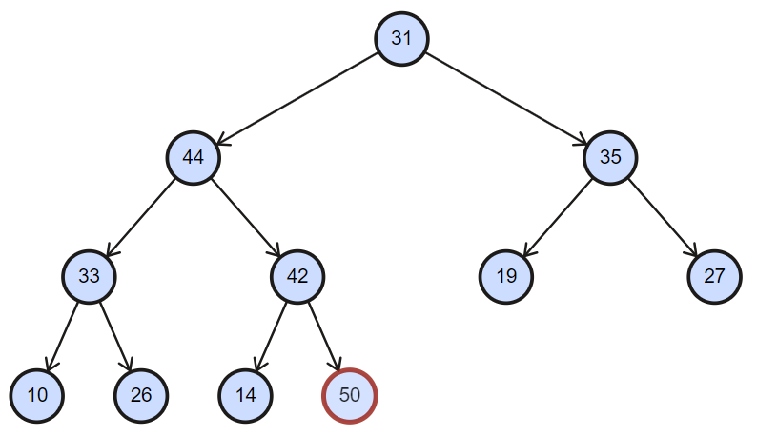
Heap Operation: Maxheapify()/Sink()
Delete Root
Swap root with last element
Array Representation:
Index:
1 | 2 | 3 | 4 | 5 | 6 | 7 | 8 | 9 | 10 | 11
31 | 44 | 35 | 33 | 42 | 19 | 27 | 10 | 26 | 14 | 50

Slide 18
Heap Operation: Maxheapify()/Sink()
Delete Root
Array Representation:
Root is now Smaller!!
Swap the root with its greater child :)
Index:
1 | 2 | 3 | 4 | 5 | 6 | 7 | 8 | 9 | 10 | 11
31 | 44 | 35 | 33 | 42 | 19 | 27 | 10 | 26 | 14 | 50

Slide 19
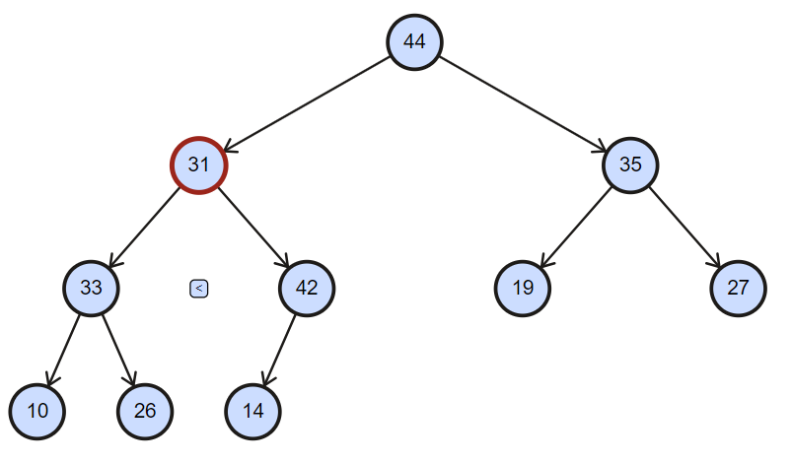
Heap Operation: Maxheapify()/Sink()
Delete Root
Array Representation:
Root is now Smaller!!
Swap the root with its greater element :)
Index:
1 | 2 | 3 | 4 | 5 | 6 | 7 | 8 | 9 | 10 | 11
44 | 31 | 35 | 33 | 42 | 19 | 27 | 10 | 26 | 14 | 50

Slide 20
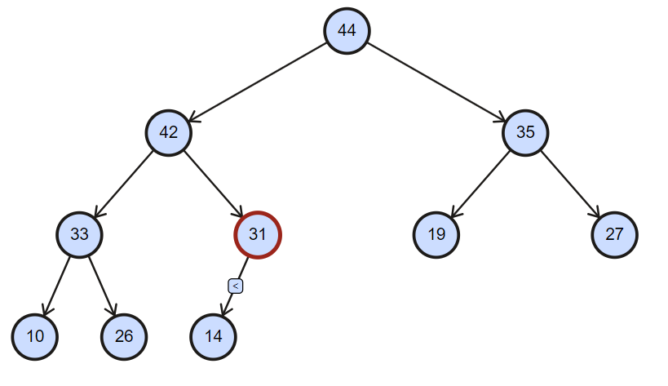
Heap Operation: Maxheapify()/Sink()
Delete Root
Array Representation:
Index:
1 | 2 | 3 | 4 | 5 | 6 | 7 | 8 | 9 | 10 | 11
44 | 42 | 35 | 33 | 31 | 19 | 27 | 10 | 26 | 14 | 50

Slide 21
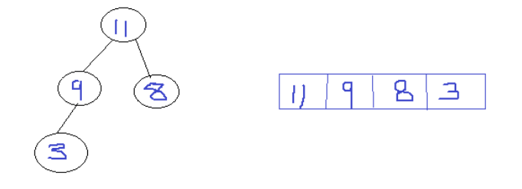
Heap Sort
Delete All the elements

Slide 22
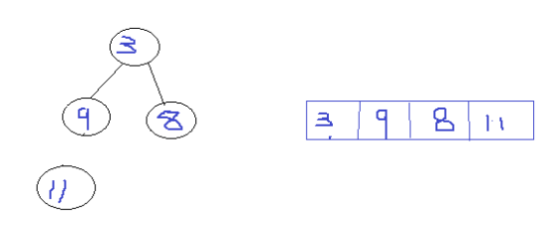
Heap Sort
Delete All the elements

Slide 23
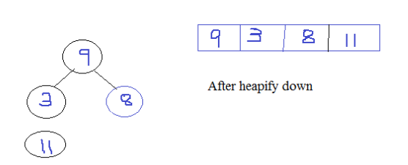
Heap Sort
Delete All the elements

Slide 24
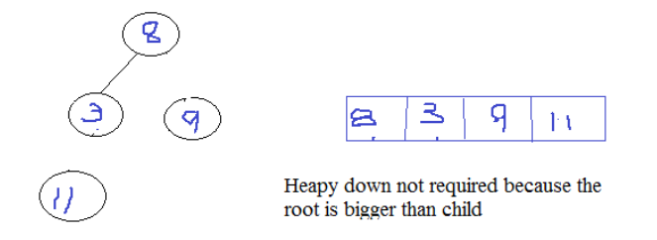
Heap Sort
Delete All the elements

Slide 25
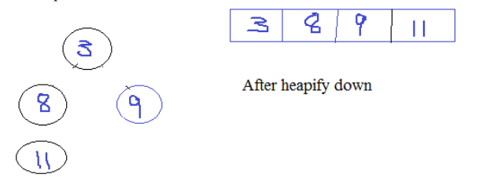
Heap Sort
Delete All the elements

Slide 26
Heap Sort: Task
Delete All the elements

